Slide 1
DATA & PRE-PROCESSING
RAM MANDIR

Slide 2
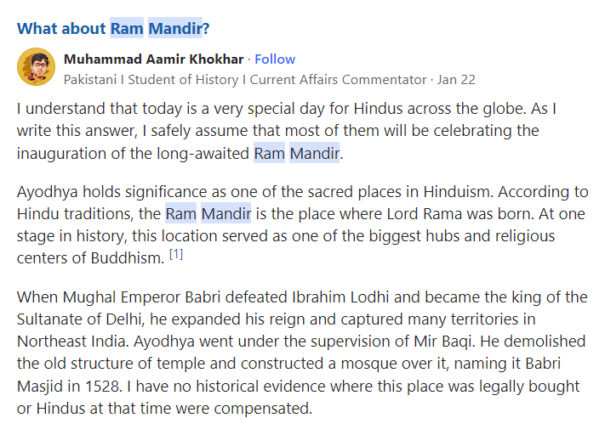
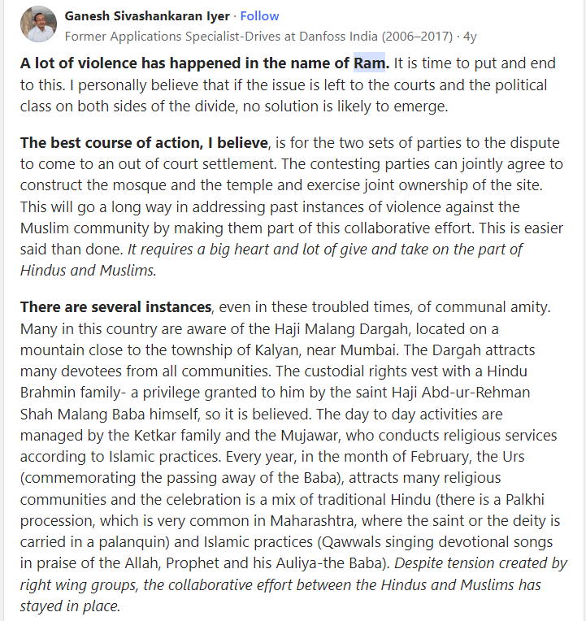
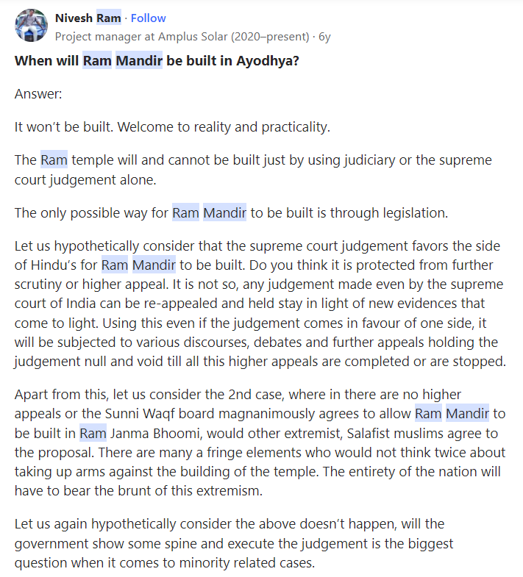
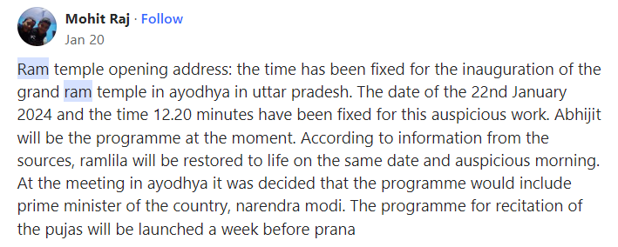
01. Various Opinions

Slide 3
01. Various Opinions
90
434
1356

Slide 4
01. Various Opinions
Positive
Hindus who believe in the historical and religious significance of the site view the Ram Mandir as a fulfillment of a longstanding desire and a symbol of cultural revival.
Neutral
Some individuals might hold neutral opinions, acknowledging the significance of the issue for both Hindus and Muslims but avoiding taking sides.
Negative
Some Muslims with historical and religious connections to the site view the construction of the Ram Mandir on the disputed land as a violation of their religious rights and a setback to interfaith harmony.

Slide 5
02. Opinions Domination
There is Positive opinion that dominates the discussion about the Ram Mandir Pran Pratishtha. It's a complex issue with diverse perspectives, and each viewpoint holds significant weight and representation within different sections of Indian society

Slide 6
03. Content Repetition
High interest: When something resonates strongly with audiences, creators often revisit it due to demand, leading to multiple versions or similar pieces. Think sequels, trending topics, or popular memes.
Limited source diversity: If there are few sources or perspectives on a topic, content naturally overlaps as creators rely on the same information or tropes. This can happen in niche fields, echo chambers, or under restricted access to information.

Slide 7
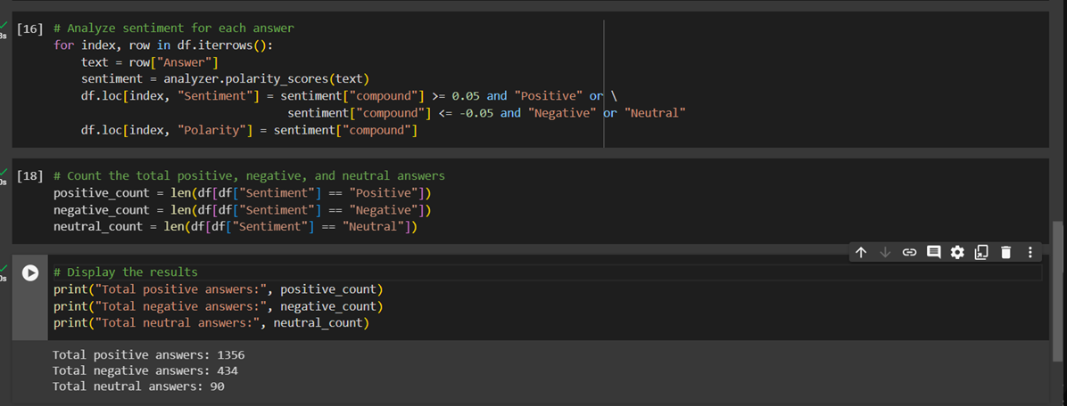
03. Content Repetition
Sentiment Analysis

Slide 8
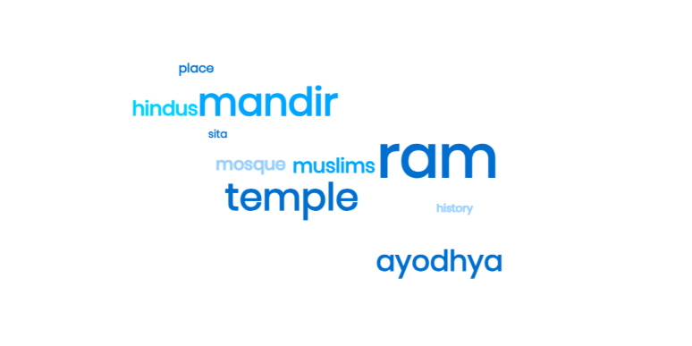
03. Content Repetition

Slide 9
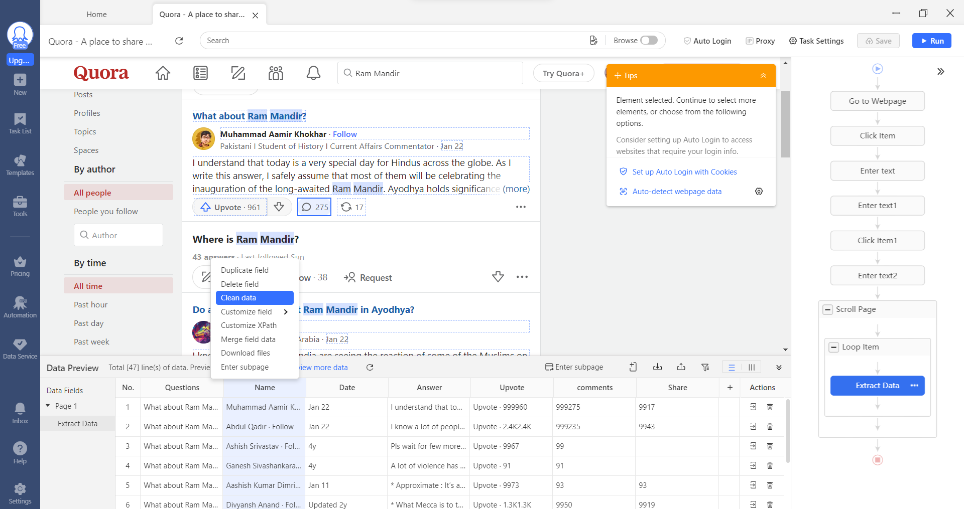
04. Data Cleaning
Data Cleaning Using Octoparse

Slide 10
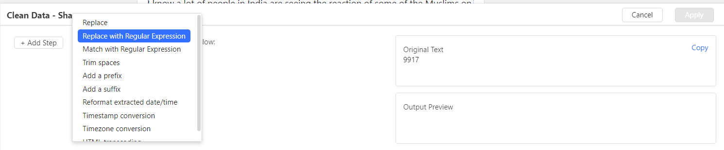
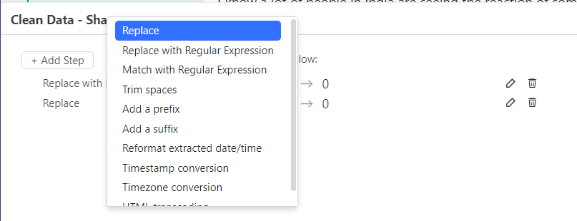
04. Data Cleaning
Replace With Regular Expression
data replacement refers to the process of filling in missing values or outliers in a dataset with alternative values. In this dataset of Ram Mandir blank spaces replaced with constant values which is zero.
Data removal involves completely eliminating entries or features from the dataset that are considered unusable or irrelevant. In this dataset the unwanted data is removed to make data more clean

Slide 11
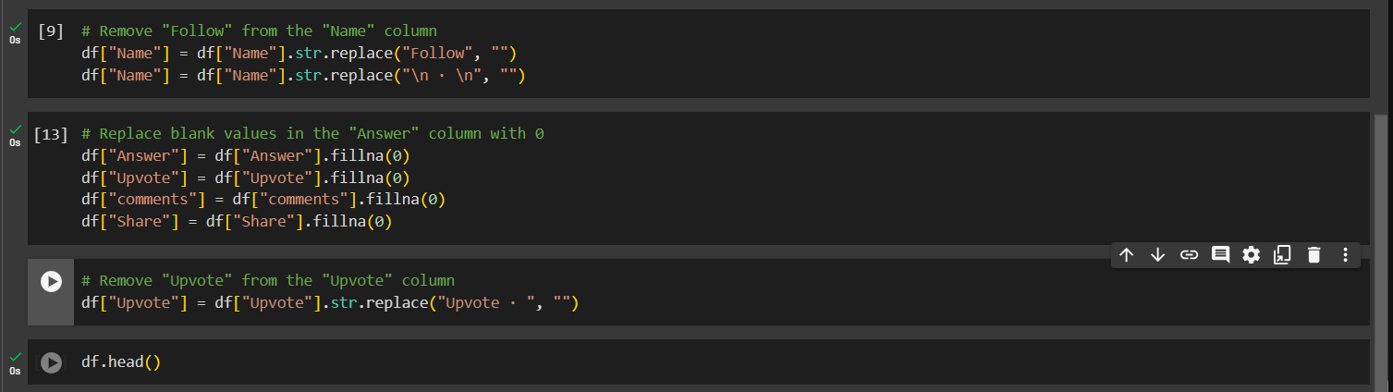
04. Data Cleaning
Data Cleaning Using Python
To clean data using python we use two techniques data replacement which replace data with some constant value & data removal which remove unwanted data to make data more clean.

Slide 12
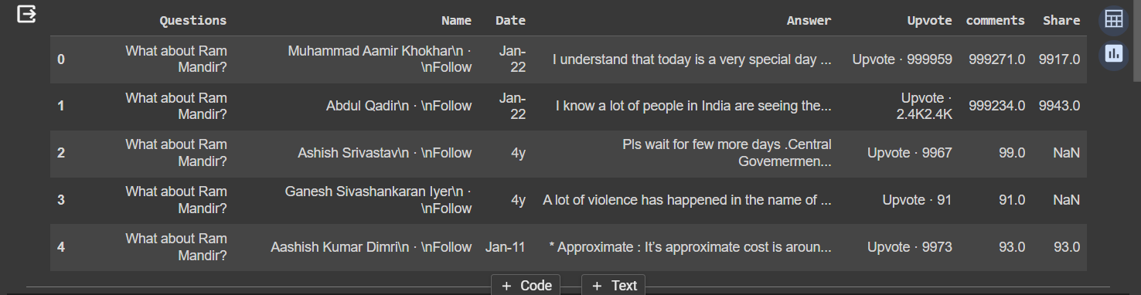
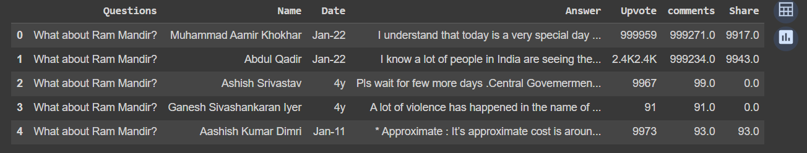
04. Data Cleaning
Data Cleaning Using Python
Before
After

Slide 13
Conclusion
Feature | Octoparse | Python
Ease of Use | Point-and-click interface, visual workflows | Requires coding knowledge
Learning Curve | Gentle, low barrier to entry | Steeper learning curve
Data Sources | Web scraping, APIs | Wide variety, including web, databases, files
Data Cleaning Functionality | Limited built-in functions | Extensive libraries with advanced capabilities
Customization | Limited scripting options | Highly customizable with code
Scalability | Good for small to medium datasets | Handles large datasets efficiently
Cost | Free plan with limitations, paid plans available | Open-source and free, optional libraries may have costs
Community Support | Growing community, but limited compared to Python | Large and active community, extensive resources available

Slide 14
Thank You

